Slide 1
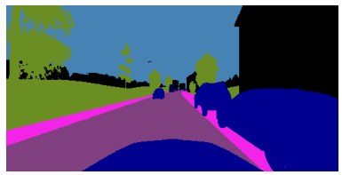




Slide 2
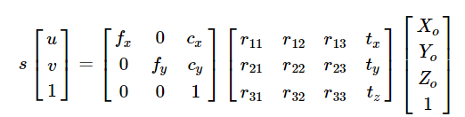
INVERSE PERSPECTIVE MAPPING
Camera
Intrinsics
Camera
Extrinsics
World-to-road
Transformation
Image
Coordinates
Camera Coordinates
World Coordinates
Road Coordinates
PERSPECTIVE MAPPING

Slide 3
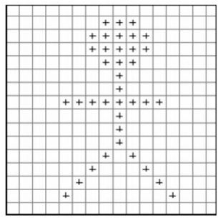
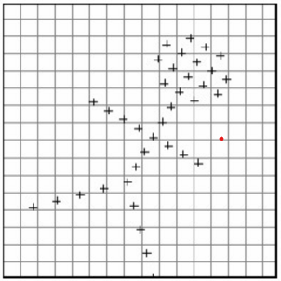
Input Image
Transformed Image

